Slide 1
CWC PCC
Yuanhua Zhao, Yuxuan Gu

Slide 2
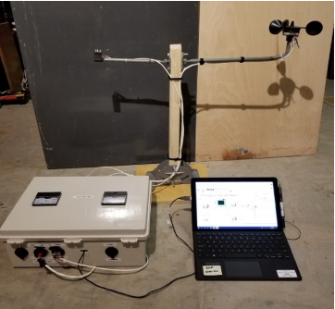
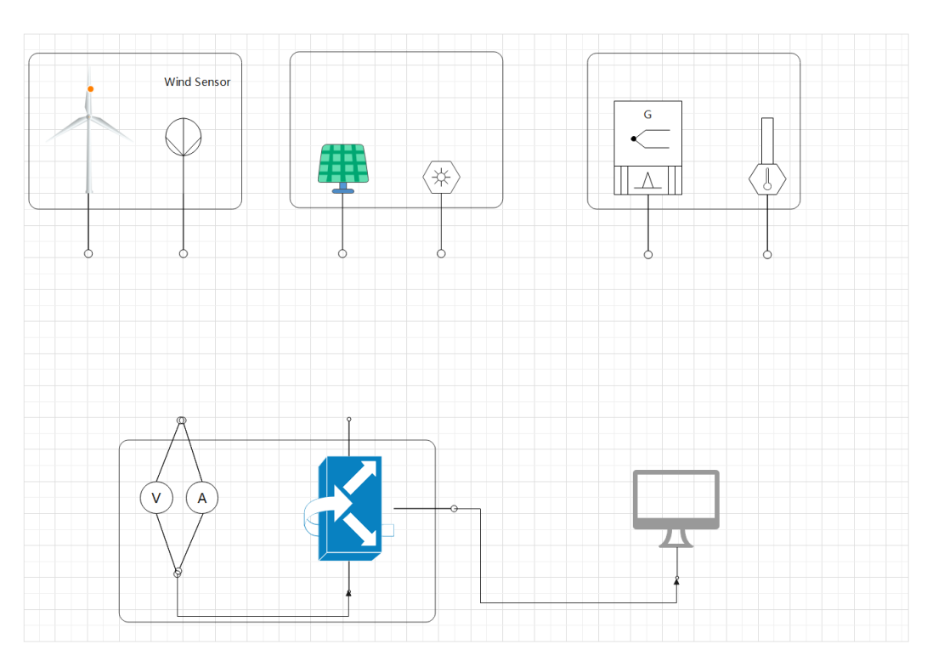
Introduction
This project will extend the capabilities of the current CWC PCC data collection system. It will add in a more flexible load option and higher resolution acquisition for characterizing solar cells and thermoelectric generators that would be used for Energy Club outreach activities. The current system collects voltage, current, wind speed, temperature, and pressure to characterize wind turbines.
Sponsor: David Willy
Client: Northern Arizona University’s Energy Club
Notes:
Introduction and understanding of the project problem

Slide 3
Customer Requirements (CRs)
Easily carry
Except load
Solar
Have done yet
Easily use
All steps on team’s handout
Thermoelectric
Wait for test environment
Easily debug
Easy to who know labview
Reliability
Need input to be larger than we thought before
Engineering Requirements (ERs)
Weight & Size
Under controlling
Simple operating system
Need output data to the excel we give
Test interface
Quiet safe.
Modularization
Base on interface and subsystem
Durability
Can test for hours
Price
Low to the budget limit
Reliability
Need input to be larger than we thought before
Notes:
Understanding of the requirements and specifications

Slide 4
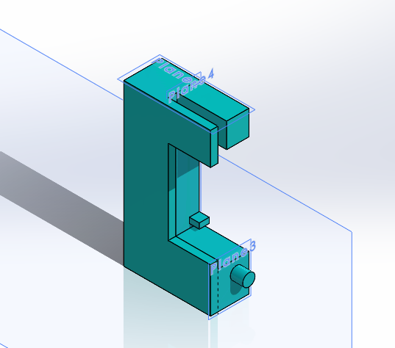
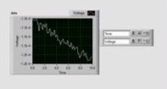
Solution
CAD/3D printing -
1.testing environment
2.base
Subsystems -
1.Wind turbine System
2.Solar Power System
3.Thermoelectric System
4.Data collection system
Labview Vi
Excel
Notes:
Design solution to the project problem

Slide 5
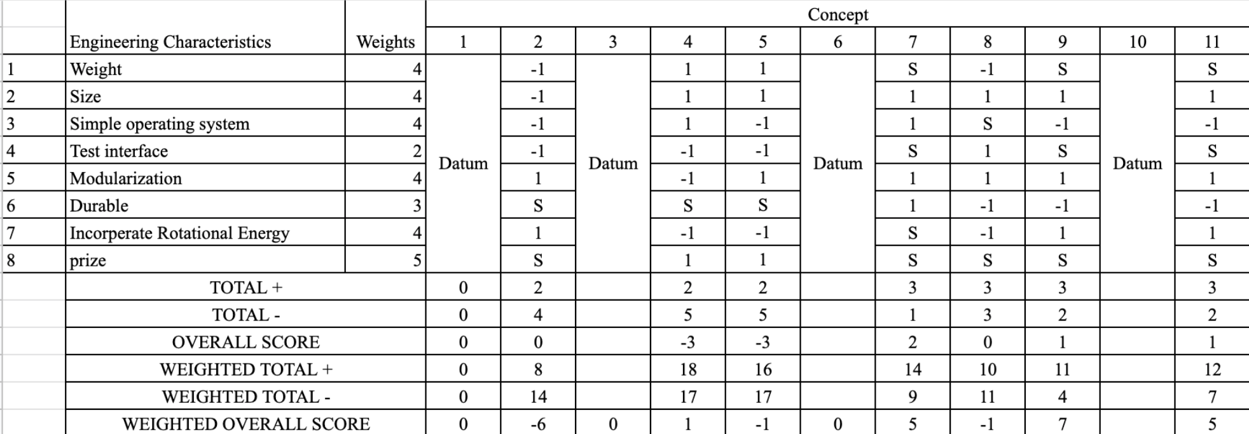
Design Making - Final
Operating system - MCU
Wind turbine test environment - box fan
Thermoelectric test environment - ice
Base - 3D printing

Slide 6
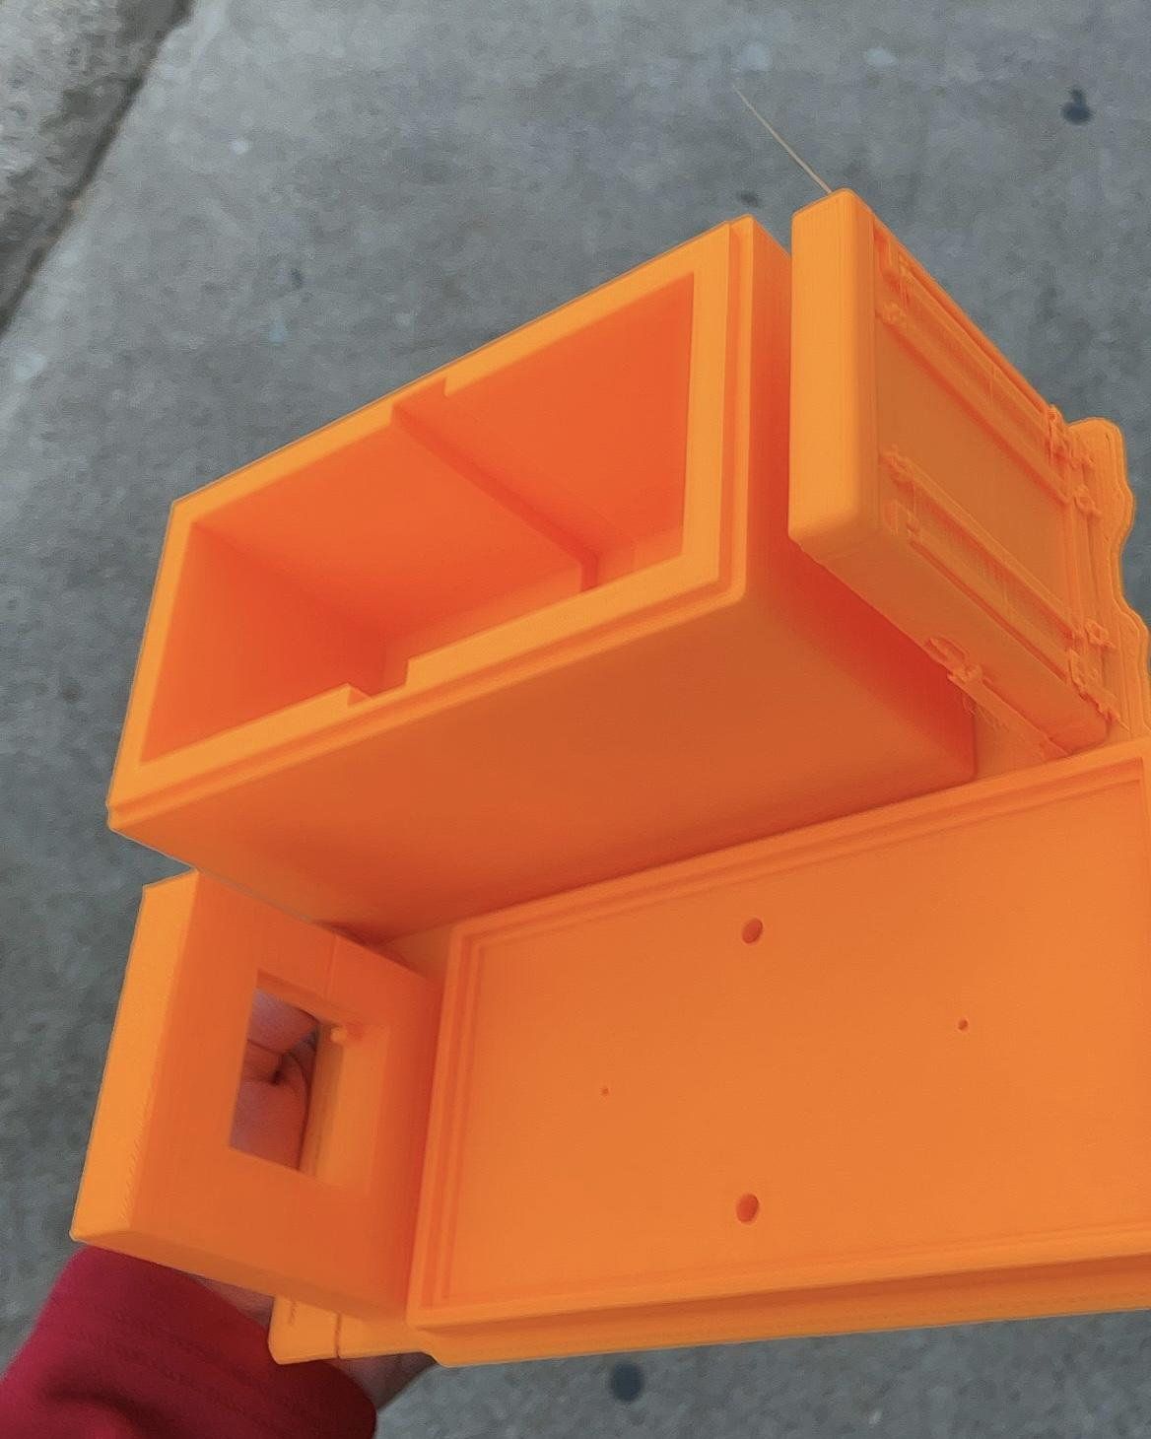
Manufacturing
Electronic parts: Soldering
Other parts: Carpentry ➡ 3D-Printing
Notes:
Design Making

Slide 7
Testing
Calibration
Data Collection with Changing Independent Variables
Short-circuit test with Controlled Independent Variables
V
I
v (m/s)
V
Notes:
Manufacturing and testing final project solution

Slide 8
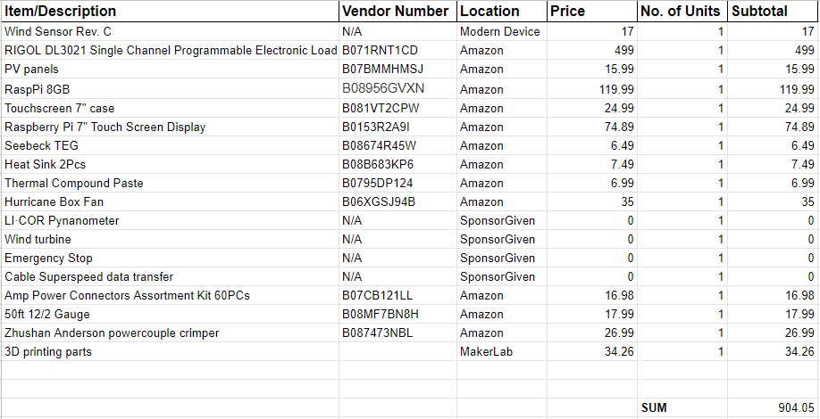
Budget ($1500 Total)
Notes:
Budget

Slide 9
Future Work
Testing (subsystem, whole system)
Operation Manual
(Improve LabVIEW Programs)
Notes:
Future Work

